Slide 1
Change in Care Provided to Grandchildren by Older Grandparents in Rural China Associations with Shifting Demographics in the 2000s
Merril Silverstein, Ph.D.
Ying Xu, M.A.
Wencheng Zheng, M.S
Syracuse University
Syracuse University
Presented at the CEPAR INTERNATIONAL CONFERENCE on Population Ageing: Causes, Consequences and Responses, July 3, 2023

Slide 2
Changing Conditions in China
Grandparents in rural China have been documented as providing both intense and casual caregiving to their grandchildren, much of this driven by large internal rural-urban migration of the working age population and leading to “left behind” grandchildren.
Personal and social circumstances of grandparents in China have changed in recent years, some enhancing the capacity to provide care (better health) and others reducing the demand to provide care (smaller families).

Slide 3
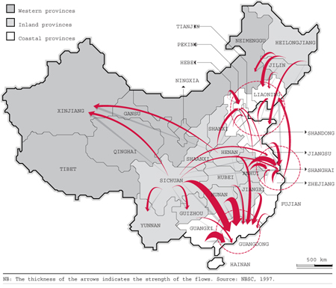
Migration Streams in China

Slide 4
Purpose of Research
To examine historical change in grandchild care by comparing two age-matched cohorts of Chinese grandparents 17 years apart
To identify the extent to which historical change in grandchild care is attributable to change in family conditions and change in health and other resources of grandparents

Slide 5
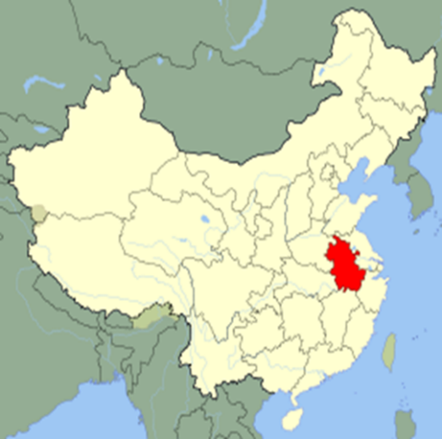
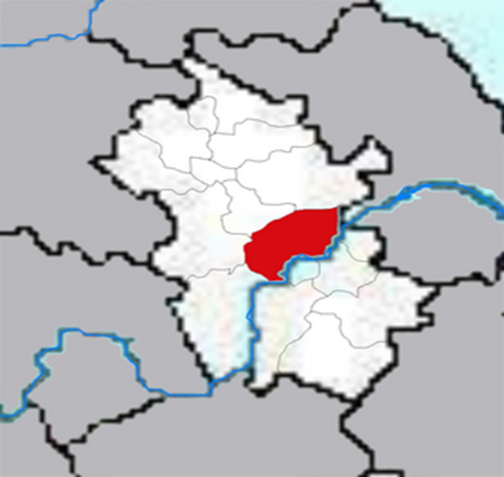
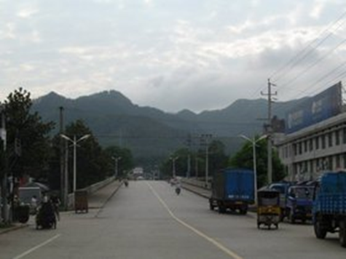
Longitudinal Study of Older Adults in Anhui Province China
Random sample of 1,798 older adults (60+) in 2001 from rural villages in Chaohu region of Anhui Province surveyed over eight waves with replenishment
2001
Wave 1 Survey
2006
Wave 2 Survey
Wave 3 Survey
2009
Wave 4 Survey
2012
2015
2018
2021
Wave 5 Survey
Wave 6 Survey
Wave 7 Survey
Wave 8 Survey
2003

Slide 6
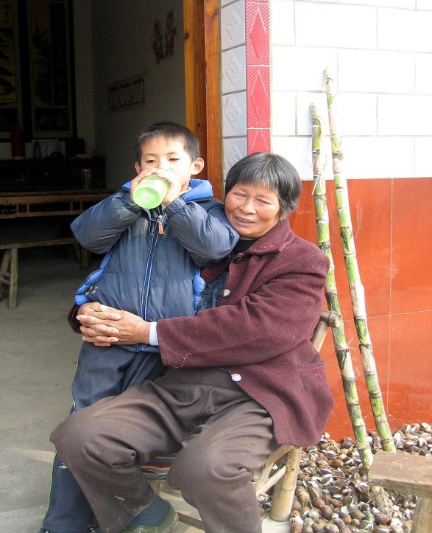
A Chaohu Village

Slide 7
Operational Sample
Two age-matched non-redundant cohorts of individuals 60-77 in 2001 & 2018 selecting grandparents with at least one grandchild 16 years old or younger
Cohort/Year | N | Mean Age
2001 | 1,185 | 68.2
2018 | 777 | 66.8

Slide 10
Outcome Measure
How often do you care for your grandchildren? (asked about sets of grandchildren from each adult child with at least one child <=16)
Seven responses ranging from none to full-time
Three categories (aggregated maximum):
No care (ref)
Part-time care only
Full-time for at least one grandchild

Slide 11
Grandmother vs. Grandfather Caregivers
There is little cohort change in full-time caregiving by grandfathers relative to not providing care.
Qualitative research shows that grandfathers are more peripheral caregivers than grandmothers, often in an indirect supporting role or answering on behalf of their wives.
Supporting this is our finding that if widowhood had not declined, grandfathers would have been significantly less likely to be a full-time caregiver in 2018.
Therefore, we focus the remainder of the analysis on grandmothers.

Slide 13
Analytic Technique
Oaxaca-Blinder decomposition using multinomial logistic regression to attribute the percent of cohort change in care due to change in the following endowments:
Change in family factors
Change in resource factors
Unexplained change
Multinomial contrasts with no care as reference group:
No care vs. part-time care
No care vs. full-time care
O-B decomposition posits the counter-factual of what the 2018 cohort would be if it resembled the 2001 cohort on salient endowments.

Slide 14
Operationalizing Cohort Change in Grandmothers Caregiving for Grandchildren
 | Part-time Care (vs No Care) | Full-time Care (vs No Care)
2001 Cohort | 55.4% | 31.8%
2018 Cohort | 22.3% | 43.0%
Cohort Change (2001→2018) | -33.0% | +11.2%

Slide 15
Family and Health Variable Clusters in O-B Analysis
Family variables
Number of children (up to five)
Number of grandchildren
Presence of migrant son
Health variables
Sum of nine functional limitations
Self-rated health
Age
Control variables
Any formal education
Widowed

Slide 16
Cohort (2001→2018) Change in Part-time Caregiving by Grandmothers: Endowment Effects
Notes:
Lower full-time care in 2001 is more explained by health deficits compared to 2018. Not impacted by family size change.

Slide 17
Cohort (2001→2018) Change in Part-time Caregiving by Grandmothers: Endowment Effects
Notes:
Lower full-time care in 2001 is more explained by health deficits compared to 2018. Not impacted by family size change.

Slide 18
Cohort (2001→2018) Change in Part-time Caregiving by Grandmothers: Endowment Effects
Notes:
Lower full-time care in 2001 is more explained by health deficits compared to 2018. Not impacted by family size change.

Slide 19
Cohort (2001→2018) Change in Full-time Caregiving by Grandmothers: Endowment Effects
Notes:
Lower full-time care in 2001 is more explained by health deficits compared to 2018. Not impacted by family size change.

Slide 20
Cohort (2001→2018) Change in Full-time Caregiving by Grandmothers: Endowment Effects
Notes:
Lower full-time care in 2001 is more explained by health deficits compared to 2018. Not impacted by family size change.

Slide 21
Cohort (2001→2018) Change in Full-time Caregiving by Grandmothers: Endowment Effects
Notes:
Lower full-time care in 2001 is more explained by health deficits compared to 2018. Not impacted by family size change.

Slide 22
Summary
Rural Chinese grandparents between 2001 and 2018 were
Less likely to provide moderate amounts of care partly because of reduced family demand for their services
More likely to provide full-time custodial care because of their improved capacity. Almost half of the increase in custodial care explained by health improvements.

Slide 23
Discussion
Health, social, and economic changes in China have both reduced and enhanced grandmothers’ involvement in the care of their grandchildren. Overall, care has declined, pointing to reduced need for grandparent care.
Health improvements explained most of the increase in custodial grandparenting. Rural Chinese grandparents are better equipped as custodial caregivers and valued assets for working children, even as opportunities for more casual caregiving have declined.
Suggests that economic growth in China over the last 20 years enabled by rural-urban migration of working age population has been sustained by focusing involvement of grandmothers in the care of their left-behind grandchildren.

Slide 24
Thank you for listening! We thank the National Natural Science Foundation of China (71573207, 72074177) and the Fogarty International Center of the National Institutes of Health (R03 TW01060) for funding this project. Special thanks to Prof. Li Shuzhuo and his research team at Xi’an Jiaotong University for their collaboration and invaluable contribution to the data infrastructure of this project.

